Slide 1
Java Basics

Slide 2
Evolution of Computer Languages
As known, CPU finally executes only binary instructions, or machine Language. However, it is tedious and time consuming to directly develop Applications in Binary. Hence Assembly language was used(Mov A,B ADD A,C)
A Compiler translates High Level Language program to Machine code. For eg. C, C++, Java are various Compilers.

Slide 3
Lexical Tokens:
Below are basic building blocks of any Java program. Below are smallest bits and piece that can exist in a Java program.
1.Keywords
int test12 = 10, i;
int TEst12 = 20;
Int keyword is used to declare integer variables
All Key words are lower case(small letters)
java is case sensitive language
In the Java programming language, a keyword is one of 50 reserved words that have a predefined meaning in the language;
because of this, programmers cannot use keywords as names for variables, methods, classes, or as any other identifier.
Can we create a keyword? Can we remove an existing keyword, in Java?
2.Identifiers
Names given to variables, class, package, methods.
Generally starts with letter followed by letters or digits, _(underscore). Other special characters like &, %,#, not allowed in identifiers.
Eg. 3test is invalid identifier, since it starts with digit.
Test3 is valid identifier. Since java is case sensitive, test and Test are considered as two different variables.
3.Literals or Fixed value
double check = 2.3;
A Literal of any data type can exist, int literal , float literal, String literal,etc..
String inst_name = "java fast Track";
2.3 is literal
"java fast Track" is String literal

Slide 4
int itest = 10;
Keyword
separator
Identifier
operator
Literal

Slide 5
Tokens:
4.Operators
Arithmetic, Logical, bit wise, relational or comparison, Assignment
5.Separators: separators are symbols which are used to syntactically separate statements or part of program. Separators improves readability of program.
; - end of statement Eg: int i=20;
, - statement separator Eg: int j,k;
() - function name, casting,etc..
{} - indicates begin and end of method, class, a block
[] – used for arrays
Eg: void my_method()
{ }
6.Whitespace and comments
Java is free form language., i..e space, tabs can be used between tokens, to improve readability of a Java program .
Comments are used for documentation purpose. Compiler does not check for syntax within comments
All professional programs need to have meaningful comments, whereever possible.
There are two types of comments in Java
// single line comment
Single line comment starts with //, and ends at end of line
/* with in a line or multi line comment */
nested multi line comments are not valid
Eg. Int i/* variable i*/,j;
Are nested multi line comments allowed?
/*
/* */
*/

Slide 6
Program code and data
Any Software program has Source code and data. Program takes the input as data, and outputs data.
In Java, Data types are broadly classified into two
Primitive or basic data types(int, float,etc..). These are in built, and a new primitive data type cannot be created by developers. Primitive data types are provided by Java, as keywords, like int float, double,etc..
Non primitive data types(any class, interface, etc.). These are built by developer, and may be based on primitive or other non primitive types.
Program which processes data
Input data
Output data

Slide 7
Primitive or Basic Java data Types
1.Integer Types(Non decimal Types)
Integer types cannot store decimal part. Different Integer Types differ in memory size and range of values.
byte 1 byte [i..e 8 bits], -128 to 127
short 2 bytes, -2¹⁵ to 2¹⁵-1
int 4 bytes, -2³¹ to 2 ³¹ -1
long 8 bytes, -2⁶³ to 2⁶³-1
Unsigned values are not supported in Java
Signed and Unsigned keywords do not exist in Java
2.Decimal Types: used to store numeric data with decimals or fraction part, For eg. Temperature, petrol price,etc…
float 4 bytes -3.7e-38 to 3.7e+38(Scientific or Exponential notation)
NOTE:-3.7e-38 means -3.7 X 10⁻³⁸ So range is-3.7 X 10 ⁻³⁸ to 3.7 X 10 ³⁸
double 8 bytes
-1.4e-308 to 1.4e+308
Scientific notation is used to express very small or big values
Below is snapshot of byte in Memory
0 | 0 | 1 | 0
Data bits
Sign bit(0- positive, 1 – negative)

Slide 8
3.Character Type : char In C language 1 byte is used to store each character
C supports, ASCII character code(can represent only 255 different characters), and supports only English related characters
In Java 2 bytes are used to store each character
Java uses UNICODE character code
Can represent 65,535 different characters includes Japanese, Hindi, Kannada, Telugu, Tamil, etc....
Though UNICODE uses extra 1 byte, for each character, it supports most of the international characters directly, unlike ASCII code. Eg: char c = ‘A’;
Java has built in support for internationalization(i18n)
4.Boolean uses 1 bit storage
boolean possible values are true, false
Eg: boolean raining=true;
5. void means no type, generally used when a method does not return any value.

Slide 9
Operators
Operators are used to perform certain operation on the operands, and produce result.
1.Arithmetic
+, -, *(multiplication), /, %(Modulo) - reminder of division[5%2 is 1]
++(increment) x++; means x = x+1;(increases value by 1)
--(decrement)(decreases values by 1)
Post increment x++; Pre increment ++x;
Arithmetic operations can be performed between variables or fixed values(i..e Literals) of any numeric data type
2.Relative or Comparison x<3,>, <=, >=, a==b( checking equal to), !=(not equal to) . Generally used with if statement
Used to compare variables or constant values
Generally Relational or Comparison expression evaluates to true or false
3.Logical: Logical operators are used to combine two or more Relational or Comparison expressions(shown above).
&&(Logical and) true only when both are true Eg.(y==3)&&(z>20)
||(Logical or), true when any one is true Eg. (rt>30)||(ot>40)
!(Logical not) – negates the logical expression

Slide 10
Operators
4.Assignment
Assignment is used to assign a variable or a fixed value to another variable.
=, +=(short hand assignment)
-=, *=, /=, %=
For eg. x+=y means x=x+y; X*=y; means x =x*y;
5.Conditional or Ternary Operator
?: condition?statment1:statement2;
If condition is true statement1 is executed, else statement2 is executed
It is called Ternary operator, as it will take three operands.
6.Bitwise
&- bitwise AND,|-bitwise OR,^ -bitwise XOR,<<(bit wise left shift),>>(bit wise right shift)
16&8
0010000(binary representation of 16)
0001000(binary representation of 8)
_______
0000000

Slide 11
Below tools are Required to develop java Programs
As known execution of Java program has two steps Compilation and interpretation. Hence Java is Compiled and Interpreted language.
1.JDK(Java Development Kit) – This is used to compile .java file to .class file. Javac command is used to compile a java program(Generally developer performs this step). JDK 1.8
2.JRE(Java Runtime Environment) – JRE has JVM(Java Virtual Machine) and run time libraries. JRE is used to execute/run/interpret .class file(Generally end user performs this step, directly or indirectly)
3. Any IDE(Integrated Development Environment). IDE is just like workbench, to write, compile , debug and run code. IDE is optional. Eclipse , Netbeans, Intellij, are most widely used IDEs.
NOTE: Instead of IDE command line also can be used
Generally 1 and 2 are provided by Sun/Oracle, IDE may be provided by some other third party.
JSE stands for Java Standard Edition, which has all packages related to Core Java
J2EE means Java 2 Enterprise Edition, which has all packages related to Advanced java(like Jsp/servlets/EJB/etc…)

Slide 12
How Java is Platform Independent?
Since java is interpreted, it executes relatively slower
Java code(Human writeable, readable)
Command to compile java program
Javac Abcd.java
Step1: Compilation, which is performed by Developer
.class or byte code is platform independent, i..e can be executed on any platform (having different CPU or Operating System) using JRE.
.class (byte code)
Step2:Interpretation or Execution, which is performed by End user of Java Application
Java Abcd
executable
.class is platform independent representation
Command to interpret java program

Slide 13
Programs:
#1.Hello World Program
#2.Add two numbers, multiply, mod, divide.
#3.Display multiplication table of a number
#4.Bit complex mathematical expression
#5.Fibonacci series
#6.Extract and print each digit of a number
#7.Use loops to display multiplication tables from 1 to 5, and 10 multiples of each.

Slide 14
#7. Program to check Armstrong number
#8.Take a number in String format, print sum of individual digits. Eg. If “5436” is given as input, output should be 18 i..e 5+4+3+6
#9. Reverse digits of any given int and print. For eg. 4386 is input, output should be 6834
#10. Read contents of a file, append A at the end of every word, and write it back to file.
For eg, if below is contents of file
Hello How are you?
This need to be changed to
HelloA HowA areA you?A
#11. For a given int, multiply with 2 and print, whenever Enter key is pressed. Program can exit, when stop is entered by user, and enter is pressed.
#12.Print two dimensional arrays, in column major order i..e print first column numbers, then second column,etc…
#13.print two dimensional array elements diagonal wise, starting from left(consider no. of rows are same as number of columns)
#14.print two dimensional array elements diagonal wise, starting from left
#15.diff b/n runtime & compile time polymorphism

Slide 15
Array: An Array is simplest data structure which stores same type of multiple items, sequentially in main memory.
An array has a name, type, and size associated with it. Size of array is number of elements in it. Array is stored in above manner in Main Memory.
Array_name.length gives total number of elements in array
0
Index
1
2
3
4
5
56
23
52
32
41
32
Element or item

Slide 16
Array can be of any type. There are two ways an array can be declared
1. For eg. To declare an int array of size 20
int arr[] = new int[20];
//only memory is allocated, but not initialized
//new keyword is used to allocate memory
2.How to initialize arrays, below statement allocates memory and also initializes values
float marks[] ={ 34,21,42,18}; //new keyword not required
An element in an array can be referred using index as shown below.
arr[3] = 56;//to access an item in index 3
System.out.println(arr[3]);

Slide 17
Two Dimensional Arrays
0
1
2
Column Index
0
arr[0]
1
arr[2][1]
2
3
Row Index
Two dimensional array is an Array of Arrays
How to declare 2-d Array
int arr[][] = new int[4][3];
How to access an element in 2 d array
arr[0][0] = 45;

Slide 18
Two dimensional Array:
There are two ways to declare/initialize arrays
#1.
int subj_marks[][] = new int[5][10];
subj_marks[0][0] = 46;
#2.//2 rows, 3 columns
float abc[][] ={
{15,21,13},
{43,15,46}
};
double [][] temperature = {{23.4,32.5,45.3},
{42.3,37.4,39.6}};
Abc array has two rows and three columns
abc[0][1] = 58;
System.out.println(abc[1][2]);
new is keyword used to allocate memory
Number of rows and columns cannot be changed dynamically(during program execution), after creation of an array

Slide 19
Type Casting:
Type Casting is converting one data type to another, and Type casting is allowed only between compatible types. Since Java is strictly or strongly typed language, Type casting is required to convert bigger values into smaller. For eg.
float tmp = (float)23.7;
int marks = (int) 56.37;
NOTE: Compiler treats 3.52 as double by default. To store 3.52 in float variable, u need to use 3.52f or typecast it, as shown above. long literals need to be suffixed with l or L
Type Promotion: Automatically converting a data type of smaller size to a bigger one. For example accommodating float literal in a double variable. Here int literal is promoted to double.
double abc = 3;
Source type
Destination type
Destination variable

Slide 20
#3.
if(condition1)
{
//statements
}
else if(condition2)
{
//statements
}
else if(condition3)
{
//statements
}
else //else is optional
{
}
Conditional/Control Flow statements
#1. to execute set of statement when a condition is true
if(condition)
{
//statement 1
}
Eg) . if(z<20)
{
//statements
}
#2. to execute one set of statements when a condition is true, and execute another set of statements, when condition is false
if(condition)
{
//statements 1
}else
{
//statements 2
}

Slide 21
Nested if is valid
if(condition1) //outer if
{
//statements to execute when condition1 is true
if(condition2) //inner if
{
//statements to execute when condition1 and condition2 are true
}
}
Find difference between above and below
if(condition1 && condition2 )
{
//statements to execute when condition1 and 2 are true
}
if(condition1 || condition2 )
{
//statements to execute when either condition1 or 2 is true
}
The execution flow differs when condition1 is true and condition is false

Slide 22
switch()
{
case 1:
//statement;
break;
case2:
//statement;
break;
default:
//statement
}

Slide 23
Loops are used to execute set of program statements repeatedly, until condition is true
1.for loop
for(initialization;condition;expression)
{
//…statements
}
2.While loop
while(condition)
{
//…statements
}
3.Do while loop
do{
//…statements
}while(condition);
Condition can be relational or logical expression
while executes zero or more times, entry controlled loop
do while executes one or more times, exit controlled loop
Nested loops are valid i..e for within for or for within while, etc…
break;
break exits from the loop
continue; skips current iteration and continues loop with next iteration

Slide 24
Enhanced For Loop
enhanced for loop has been introduced in Java 5 version.
It is mainly used to traverse thru individual elements including arrays or any Collection

Slide 25
How for loop works
1.for loop
for(initialization;condition;expression)
{
//…statements
}
Executes one time after each iteration(when each iteration ends
Executes only once, when execution enters loop, only for the first time
Executes one time before each iteration(when each iteration starts)
NOTE: iterations are continued until condition is true

Slide 26
How many statements we can have in for loop?
How many statements we can have in if statement?
for(int i=0;i<10;i++)
{
System.out.println(i);
}
/* Above for loop iterates 10 times, incrementing i value by 1, for each iteration
*/
//How many times below loop iterates??
for(double k=50;k>=20;k=k-0.2)
{
System.out.println(k);
}
//How many times above for loop iterates??

Slide 27
Generally break and continue statements need to be enclosed in any conditional block
Below are some valid usages of for loop
int i=0;
for(;i<10;i++) //1
{
//statements
}
for(;;)//infinite for loop //2
{
//statements
}
//multiple variables can be initialized, and multiple expression can be used in for loop
for(int i=0,j=10;i<5;i++,j--) //3
{
//statements
}
int i=3,j=5;
for(;i<5&&j>10;) //4
{
//statements
}
for(int i=0;i<10;i++);
{
//statements
}
Note: When flower braces are not
Used, by default only one statement
immediately after loop is executed
Iteratively. However, its good practice to
Use flower braces
Syntactically right, but logically may not produce expected output. Cause only for statement iterates, but not the entire block

Slide 28
enum
enum keyword is used to declare a set of constants, along with the name of constants.
For eg. Below is an example on how to declare an enum
enum Season { WINTER, SPRING, SUMMER, FALL, RAINY };
Enum is also a data type, just like class or interface
How and where to use enum?
#1. Season s=Season.WINTER;
System.out.println(s);
if(s!=Season.FALL)
{
}
#2. Season getSeasonName()
{
}
Advantages:
Rather than having multiple constants, can be declared as type, improves readability of program
Enum can be declared within the class or outside class.

Slide 29
enum
Some more details on Enumeration
Enumerations are of class type, and have all the capabilities that a Java class has.
Enumerations can have Constructors, instance Variables, methods and can even implement Interfaces.
Enumerations are not instantiated using new keyword.
All Enumerations by default inherit java.lang.Enum class.

Slide 30
Method: A method has a name and set of program statements which performs specific functionality, which takes input as arguments, processes them, and may return a value to the caller. Method improves code reusability, and reduces code duplication. A method
May have parameters, to pass input to it.
Returns a value
Is enclosed in a class, and cannot exist out side class. For example
NOTE: 1.A Program can have any number of methods, and each method can be called from other methods in program.
2. Program execution always starts from main() method
class Abc{
int x, y;
static int min( int i, int j, int k)
{
//business logic
System.out.println(“I Value is”+i);
return i;
}
}
Parameters to method
Method name
Return type(void means method does not return any value. If method returns a value, specify type like double or float or int etc…

Slide 31
Java is true Object Oriented Language
That means each and every statement need to be enclosed in class.
No source code can be written outside the class, except few special statements(which are related to packages)
Even main() method cannot exist outside the class.

Slide 32
Method Overloading:
One or more methods in a class having same name, but different number or type of arguments, is called method overloading.
When a overloaded method is called, the method with matching number and type of arguments gets executed.
If there is no exact match of argument types, type promotion is applied, before invoking the method.
For eg
class Abc{
void add(int i, int j){ //body of method }
//Int add(int i, int j){ //body of method } //compile error
void add(float i, float j, float k){ //body of method }
void add(int i,int j, int k){ //body of method }
}
NOTE:
1.Method overloading cannot be done, based only on return type of the method
2.Method overloading is compile time polymorphism, as the method which need to get called is decided during compile time itself.

Slide 33
Method Overloading:
Can below methods be overloaded??
class Abc{
void add(int i, int j){ //body of method }
int add(int a, int b){ //body of method }
}
Command line arguments: These are passed as String[] (i..e String array) to main method. Any values or Settings required, to start running the program, can be passed thru command line arguments.

Slide 34
What is a class?
A class encapsulates data members, member methods, constructors, and all three are optional
A class is a basic unit of any OO(Object Oriented) programming.
Data members can be accessed by all member methods, and even constructors.
Constructor is a special method with same name as class, and is used to initialize an object
Functionality or behavior of the class is exposed thru methods
A java program can have any number of classes
A class is a type(User defined Type), where as int is builtin type
What is an object? Generally to use a class, an object of the class need to be created.
An object is an instance of a class. And process of creation of object from class is called Instantiation. Any number of objects can be created for a class. A class is a blue print of an object.

Slide 35
class Abc{
int x,y; //data members
//constructor
Abc(){
//statements
}
//method
void met1(){
//statements
}
void met2(){
//statements
}
}
How to create object of a class?
Int x;
Abc obj;
obj=new Abc();
NOTE: A class can have zero or more data members, constructors, methods

Slide 36
Method Recursion:
A method invoking itself is called as Method Recursion. For example…
class Xyz{
void met1()
{
if(condition1)
{
met1();
}
}
}

Slide 37
Method Recursion:
When method recursion is not used appropriately, Logical errors may result in infinite recursion, and may end up with StackOverflowError.

Slide 38
What is encapsulation?
Encapsulation in Java is a mechanism of wrapping the data (variables) and code acting on the data (methods) together as a single unit.

Slide 39
Why class?
Below are advantages of class
Reduces Complexity of code
Improves readability of the source code
Improves maintainability, modularity
Improves code reusability
Access of the members can be controlled(using private, public, protected)
Promotes distributed development
To summarize, it reduces Time to market and Project cost.
Examples of class and object?
1. A class is like a moulder, which creates a water bottle. Water bottle is the actual object. So, the class(i..e moulder) gives the characteristics to an object(i..e water bottle)
2. A class is like a plan(of a house), and object is just like a house.
Plan of a house says how many floors, rooms, size of rooms, etc… similarly a class says how an object should be.
A java file can have any number of classes, but there can be only one public class(in a Java file). And name of public class should be same as java filename. For eg. If Abcd is name of public class, then Abcd.java should be the filename.

Slide 40
Different types of constructor?
A constructor is special method, which gets invoked when the object is getting created. A constructor initializes an object.
Constructor has same name as class
Constructor does not return anything syntactically.
If no constructors are provided by class developer, compiler itself will generate an Implicit Constructor.
A constructor with no parameters is called as Default Constructor.
Generally the terms Implicit Constructor and Default Constructor are used interchangeably.
A constructor with parameters or arguments is called as Parameterized Constructor.-----------------
A class can have multiple constructors, but each constructor need to have different number or different type of parameters. This is called Constructor Overloading.
Note that, Constructor need to have only initialization logic or preparation. It is good practice not to have business logic in constructor
There is no destructor in Java

Slide 41
return keyword need to be used in the method, to return a value, to the caller.
Java is a true object oriented language, that means almost everything are objects or classes.
No code can be written outside the class, except one or two special statements.

Slide 42
Scope and life of variables declared as parameters, locally, data members
Class Abc{
float x; //Data member: directlyaccessible from all methods of this class
//p is parameter, and can be accessed only within this method
void display(int p)
{
float z;
//local variable, and can be accessed only within this method
}
}

Slide 43
static keyword
A member(data member or method) of a class can be declared static. A constructor cannot be declared static.
A static member is associated with the class, and not with individual objects of the class.
Since static member is associated with class, they can be directly accessed with class name, For eg. Student.max_marks
Static members can be used even before creation of object. Memory is allocated to static members when the program gets loaded into main memory, for execution

Slide 44
Object Usage
As known a class is also a type, but it is user defined data type, unlike int, float, etc… which are built in types. As we have seen, an object can be declared as a locally within a method. An object can also be used in below different places
As a parameter to a method or constructor
As a return value
As a data member within a class
One of the aim of OOPs language is to use objects just like a built in type.
Can we have an array of objects?

Slide 45
Array as Parameter
Yes, Array(of any dimension) can be
sent as parameter to a method or constructor
Returned from a method
declared locally within a method or constructor
declared as a data member of a class
An array is internally an object

Slide 46
Static keyword…
A static method can be invoked directly from another static method. Also non static method can be directly called from another non static method.
A non static method can directly invoke static method.
But a static method cannot directly invoke non static method, it can be done by creating object and invoke non static method with that.
Note: static does not mean that it is a constant.
A constructor cannot be declared static: Reason is, constructor is associated with initializing an object, where as static is not related to an object, but with class.

Slide 47
Access Specifiers
Access Specifiers can be used with any class members. An Access specifier indicates, where all the specific member of the class is accessible. Below are Access Specifiers, in Java
private – is accessible only within the class. Generally almost all data members need to be private.
public – is accessible from anywhere(within the class, and other packages also)
protected – is related to inheritance
Default or none is related to packages. Members with no access specifier are accessible only within current package.
NOTE: Access Specifiers cannot be used with local variables, within a method.

Slide 48
final keyword
Final keyword is used for below three purposes
To declare data members or local variables as constants, i..e a variable or object declared as constant cannot be changed again. (If a final variable or object tried to change, it gives a compiler error). For eg. final float PI = 3.14f; As per naming convention, name of constants should be in Upper case letters. A final can be either local or data member.
Two other purpose of final keyword are related to Inheritance

Slide 49
Can a member of a class be private static and final?
What is Data hiding?
Data hiding is a software development technique specifically used in object-oriented programming (OOP) to hide internal object details (data members).

Slide 50
this keyword
this keyword refers to current object. this can be used in below different ways
this(); - to invoke the matching constructor from another constructor of the same class
this. – to avoid name collision between data member and parameters/local variable having same name. this. Can also be used to invoke non static methods of same class.
this – refers to current object of this class.
this(); can be invoked only from constructor(not from methods), that too it should be first line in constructor
this. and this can be used in constructor or methods

Slide 51
this keyword
this keyword cannot be used in static methods

Slide 52
Packages
A package is a bundle of classes or interfaces. The purpose of package is
Avoids name collision between classes or interfaces having same name. Eg. It is possible to have a class Abc in p1 package, and another Abc class in p2 package
Improves modularity of the code
Class members with default or none access specifier, can be accessed only within the package.
Promotes distributed development.
A package, can further have sub packages.
Below are keywords used in packages
package – indicates that the current file belongs to certain package. Each file can have only one package statement, that too it need to be first statement in a .java file
import - code in the file is dependent on class or interface in some other package. Each .java file can have any number of import statements.
A separate folder or directory is created for each package. A package can be spread across multiple .java files. When IDEs are used folder is automatically created, when a new package is created.
When code is developed with Notepad and command prompt, folder need to be manually created, with same name as package name.

Slide 53
Packages
package com.p1
package com.p2
Public Class A
(A.java)
Public Class A
(A.java)
Public Class D
(D.java)
import com.p1.B;
Public Class B
(B.java)
import com.p2.*;
Class E

Slide 54
Packages…
In a .java file, there can be only one public class, and the name of .java file must be same as public class name.
In a .java file, there can be any number of non public classes.
import p2.*; //it just imports direct classes in p2 package, but not sub packages of p2
import p2.sp1.*;
For a class member to be accessible outside the package, both class member and the class also need to be public
Generally package name takes below format

Slide 55
Built in Packages in Java…
Below are built in Packages in Java
java.lang – this package is automatically imported by all java files. For eg. String, System classes are in java.lang package.
Java.util - Collections
Java.io – Input and Output Programming
Java.sql – connecting to database
Java.net – networking or socket programming. It is used to create connection between two or more remote machines. Used to develop Applications like chat, file upload, etc…

Slide 56
Sub Packages…
A package may further have sub packages. And a sub package can further have sub packages
Same package and import keywords are used incase of declaring or using sub packages.

Slide 57
Interface
An interface is a collection of method declarations , and without method definitions(i..e with out method body)
An interface is a pure abstract class
An interface can have declarations of constants. By default Constants in interface are static and final.
For eg.
interface Circle{
double PI=3.14;
double getSurfaceArea(double radius);
double getCircum(double radius);
}
Below are the keywords used in interfaces
interface – to declare an interface
implements – used with class which provides body for interface methods
An interface cannot be instantiated, but a reference can be declared of an interface.
Private, protected members are not allowed in interface. An interface cannot have constructor(s).
Each interface can have multiple implementations. And an interface reference can refer to any object(whose class implements the interface). Hence by using interface, it is possible to switch between multiple implementations, during run time. This is called run time polymorphism.

Slide 58
Reference
class A{
//statments
}
A obj;
obj = new A();
Reference

Slide 59
Interface
An interface can extend from one or more other interfaces, using extends keyword. Hence multiple inheritance is supported in interfaces.
Constructors or static methods not allowed in interface
An outer interface can be public or default. Public interface can be used in current and other packages as well.
By default interface and methods declared in interface are abstract, of course they can be explicitly declared as abstract.
A single class can implement from multiple interfaces.
Interfaces play vital role, in developing loosely coupled classes.

Slide 60
Basic advantages of Interface
Since java does not have header file, an interface can act like a header. So when you want to provide APIs(Application Program Interface) to your clients(who may further use your classes, etc.. in their Application) without source code, you can provide them an interface, instead of actual class.
Also, when there are multiple implementations for an interface, it is possible to dynamically switch between each implementation, in the run time.

Slide 61
Wrapper class
Primitive or built in types like int, float, etc… have corresponding Wrapper classes, which wrap the built in type, along with providing additional functionality. These classes are in java.lang package. Below are the wrapper classes
Integer – int
Short - short
Byte - byte
Long - long
Float - float
Double - double
Boolean - boolean
Void - void
Note that all above Wrapper classes are final and cannot be inherited.

Slide 62
Inner class
A class can be defined as a member of another class, or within a method as well.
A Inner class within an Outer class, creates a special relationship between them, in which Inner class, can even access private members of Outer class. But methods of Outer class cannot directly access members of Inner class.
An Inner class can be declared private, public, protected or static. But Outer class can be either public or default only.
Inner Interface
It is possible to have an interface as a member of another class or interface.

Slide 63
Tools available in JDK
javac – to compile a .java file, which produces .class file
javadoc – to generate documentation. Generates HTML documentation files, for the classes and methods available in Application.
java - to run .class file
jar - to create jar file from set of .class files
How to decompile a .class file, is it possible to encrypt the .class file?
Environment Variables
What is CLASSPATH environment variable?
CLASSPATH environment variable need to be set with the paths, in which required .class files are available. There can be multiple paths, separated by ;
Java command searches for .class files in the paths set to CLASSPATH
Java – version to find java version installed on your system.
Can multiple Java versions be installed on a single machine, simultaneously?
JAVA_HOME environment variable points to the directory where the Java runtime environment (JRE) is installed on your computer.

Slide 64
Environment variables
Set the PATH environment variable if you want to be able to conveniently run the executables (javac.exe, java.exe, javadoc.exe, and so on) from any directory without having to type the full path of the command. If PATH variable is not set, you need to specify the full path to the executable every time you run it, such as:
C:\Java\jdk1.7.0\bin\javac MyClass.java
The PATH environment variable is a series of directories separated by semicolons (;). Microsoft Windows looks for programs in the PATH directories in order, from left to right. You should have only one bin directory for the JDK in the path at a time (those following the first are ignored), so if one is already present, you can update that particular entry.

Slide 65
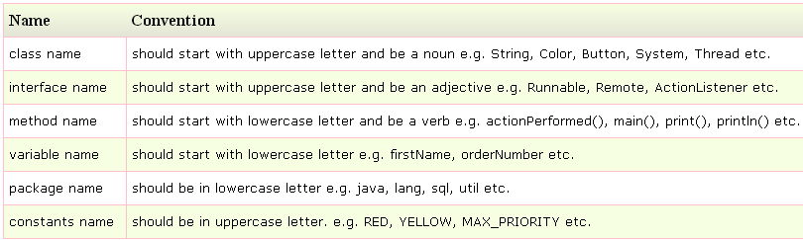
Naming Convention
Java naming convention is a rule to follow , for identifiers such as class, package, variable, constant, method etc.
But, it is not forced to follow. So, it is known as convention not rule.
Java follows camelcase syntax for naming the class, interface, method and variable.

Slide 66
String Constant pool
When we use double quotes to create a String, it first looks for String with same value in the String pool, if found it just returns the reference else it creates a new String in the pool and then returns the reference.
However using new operator, we force String class to create a new String object in heap space.
String Constant Pool is an example for Fly Weight Design Pattern.

Slide 67
Java.lang.Math
Below are the methods available in Math class
sin, cos, tan, exp, log, pow, sqrt
abstract keyword: A class declared as abstract cannot be instantiated. An abstract class may have abstract methods. An abstract method is method with only declaration, body for abstract methods is provided by derived classes. An abstract class may have constructor.
Note that interface and methods declared in interface by default are abstract, though abstract keyword can be explicitly used for interface or its methods.

Slide 68
javadoc command
Javadoc command is used to generate html documentation files.
Documentation comment is /** documentation here */
Eg.
/**
* The HelloWorld program implements an application that
* simply displays "Hello World!" to the standard output.
*
* @author Test Author
* @version 1.0
* @since 05-05-2016
*/
public class abc{
public static void main(String[] a) {
System.out.println("Hello World");
}
}
__________________
javadoc abc.java

Slide 69
jps - Java Virtual Machine Process Status Tool
The jps tool lists the instrumented HotSpot Java Virtual Machines (JVMs) on the target system. The tool is limited to reporting information on JVMs for which it has the access permissions.

Slide 70
What is debugging?
Debugging is the process of checking the workability of a program. While debugging, it is possible to run statement by statement, put break points, pause/resume execution, view/change values of any variables, during program execution.
Hence debugging helps to remove problems in the software.

Slide 71
String, StringBuilder, StringBuffer Difference
Mutability Difference: Generally there are many string instances in our applications.
String objects are immutable and their values cannot be changed after they are created.
StringBuffer and StringBuilder are mutable.
String always creates a new object when you try to update the same.
String Constant Pool Difference: String uses a pool internally unlike StringBuffer and StringBuilder. Though compiler implicitly uses pool for a String, you can explicitly do it using String s3=s1.intern();
This is advantage of String.
Here Fly Weight Design Pattern is used

Slide 72
String performance
Thread-Safety Difference: Difference between StringBuffer and StringBuilder is that StringBuffer is thread-safe.
When the application needs to be run only in a single thread then it is better to use StringBuilder.
StringBuilder is more efficient than StringBuffer

Slide 73
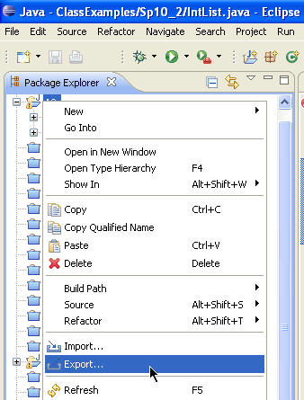
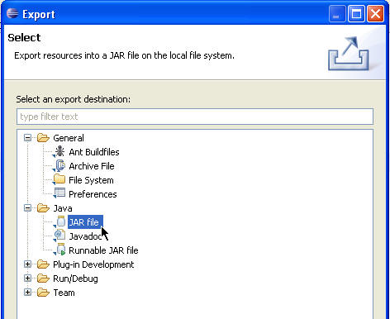
Create jar using Eclipse IDE
Either from the context menu or from the menu bar's File menu, select Export.
Expand the Java node and select JAR file. Click Next.

Slide 74
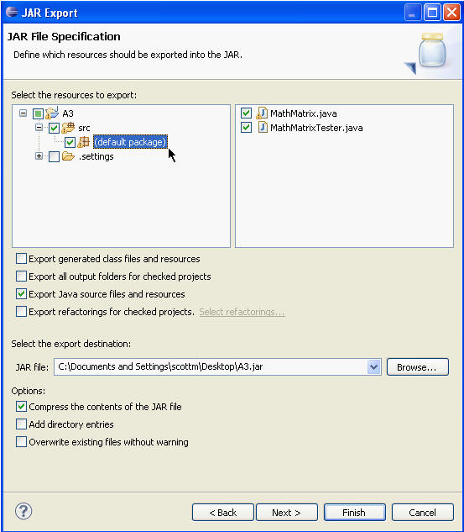
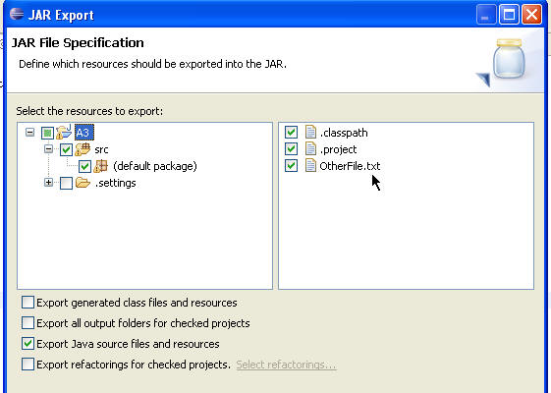
Create jar using Eclipse IDE
In the JAR File Specification page, select the resources that you want to export in the Select the resources to export field.
Select the appropriate checkbox to specify whether you want to Export generated class files and resources or Export Java source files and resources. If there are other files or resources you want to include they must be in a an open project. Browse to their location via the directory tree on the left and ensure the file or resource is checked in the window on the right.

Slide 75
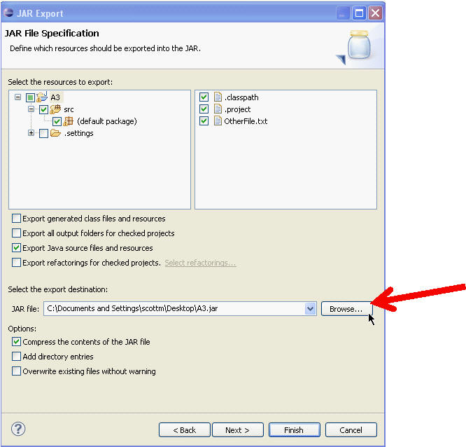
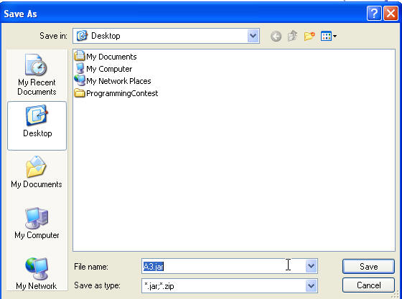
Create jar using Eclipse IDE
In the Select the export destination field, either type or click Browse to select a location for the JAR file.
Select or clear the Compress the contents of the JAR file checkbox.
Click Finish to create the JAR file immediately.

Slide 76
Jar command
A JAR (Java Archive) is a package file format typically used to aggregate many Java class files and associated metadata and resources (text, images, etc.) into one file to distribute application software or libraries on the Java platform.
Creation of JAR File?
C:\> jar cf pack.jar pack
cf represents create the file. For example, assuming our package pack is available in C:\directory
Now , pack.jar file is created
Viewing a JAR file:
To view contents of .jar files, we can use the command as:
jar tf jarfilename

Slide 77
Jar command
How to extract jar file?
jar xf pack.jar
How to create jar file which can run?
Running a JAR file: To run an application packaged as a JAR file (requires the Main-class manifest header) , following command can be used:
C:\>java -jar pack.jar
How to create a runnable jar file?
jar cfm MyJar.jar Manifest.txt MyPackage/*.class
This creates the JAR file with a manifest with the following contents:
Manifest-Version: 1.0
Created-By: 1.7.0_06 (Oracle Corporation)
Main-Class: MyPackage.MyClass
How to run jar file created above?
java -jar MyJar.jar

